Slide 1
Data wrangling is the process of transforming and mapping data from one "raw" data form into another format. [wikipedia]
Raw data:
Afghanistan is located within South Asia and Central Asia which has life expectancy of 28.801 years in 1952………

Slide 2
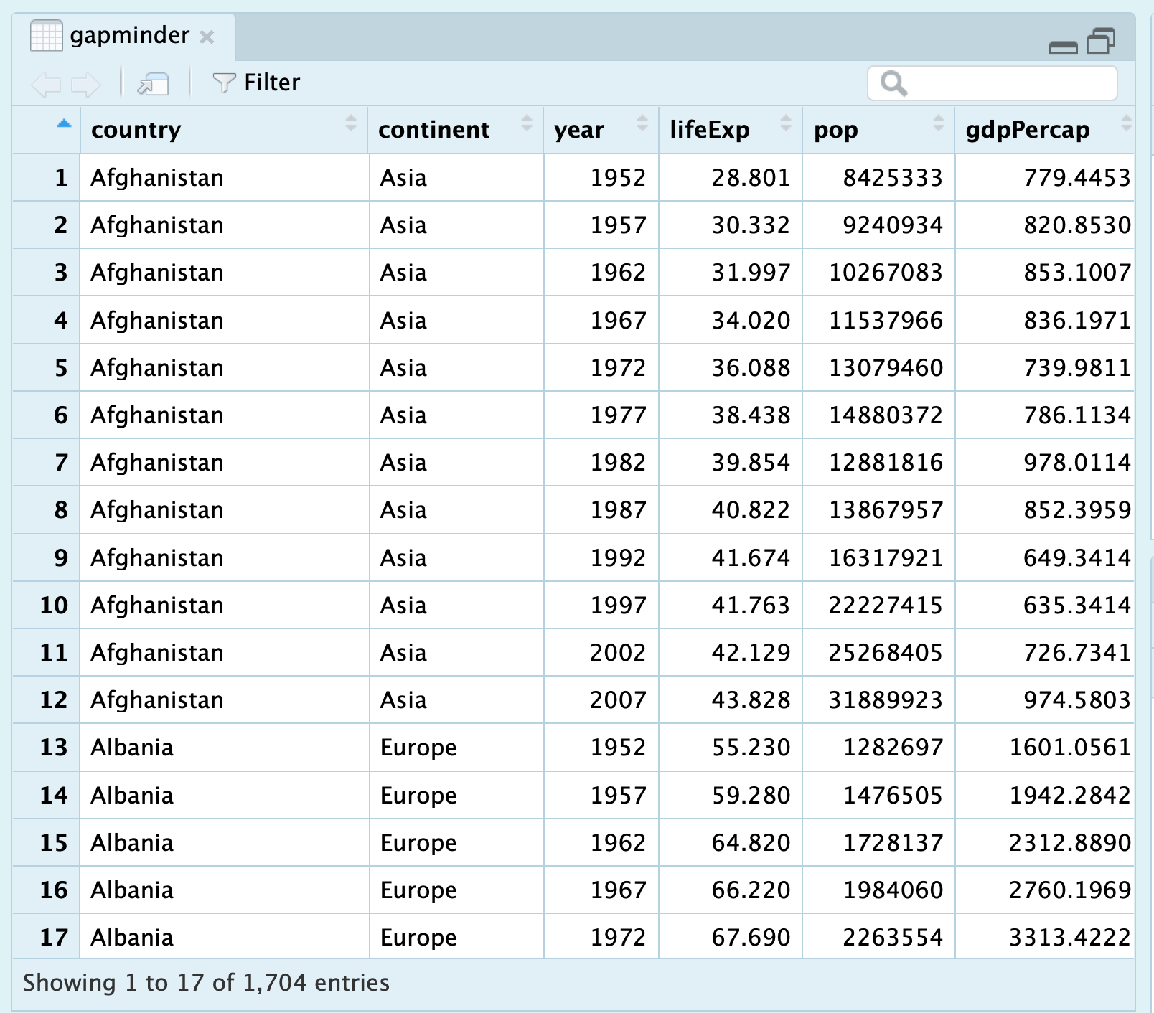
Data wrangling is the process of transforming and mapping data from one "raw" data form into another format. [wikipedia]
Raw data:
Afghanistan is located within South Asia and Central Asia which has with life expectancy of 28.801 years in 1052………

Slide 3
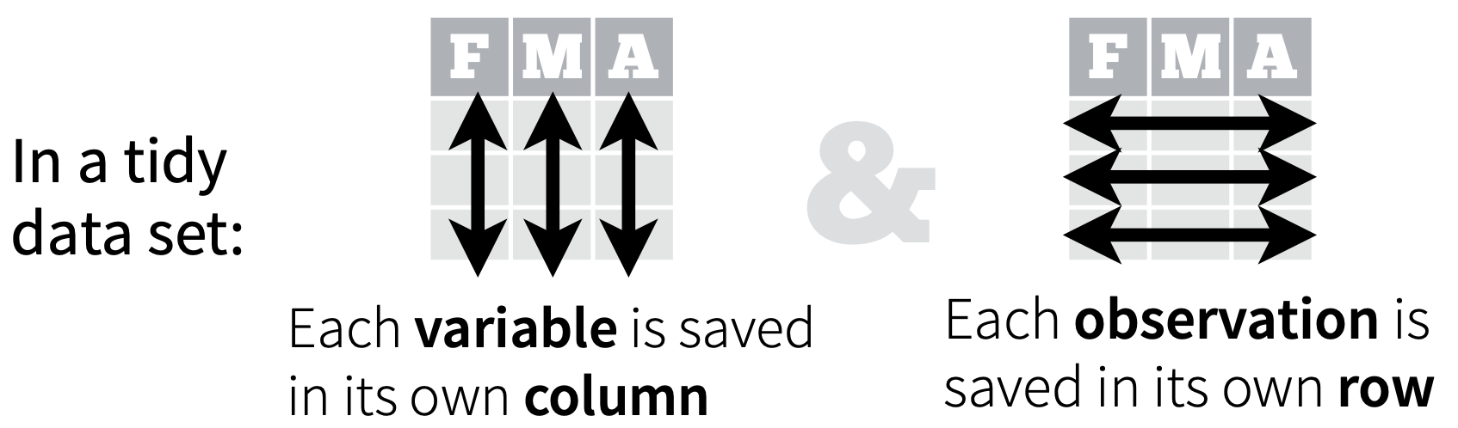
Tidy data sets are arranged such that each variable is a column and each observation (or case) is a row. [wikipedia]

Slide 4
Data wrangling and tidy data

Slide 5
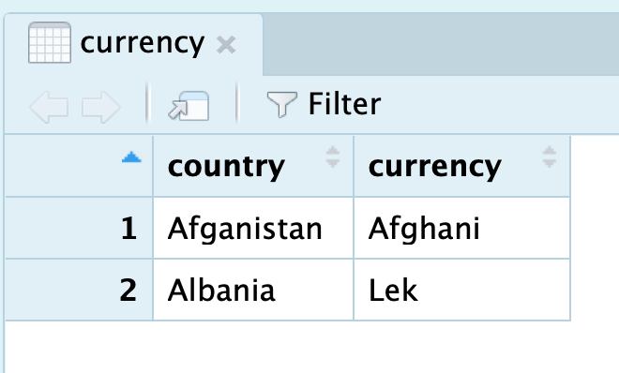
Data wrangling examples

Slide 6
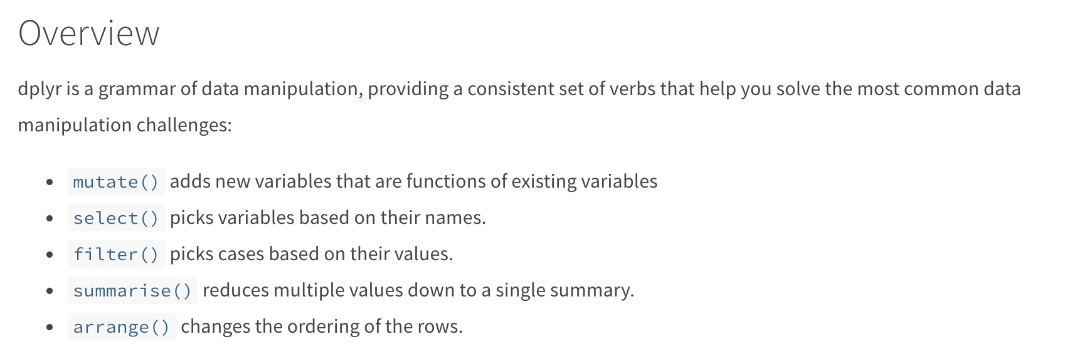
Introduction to dplyr

Slide 7
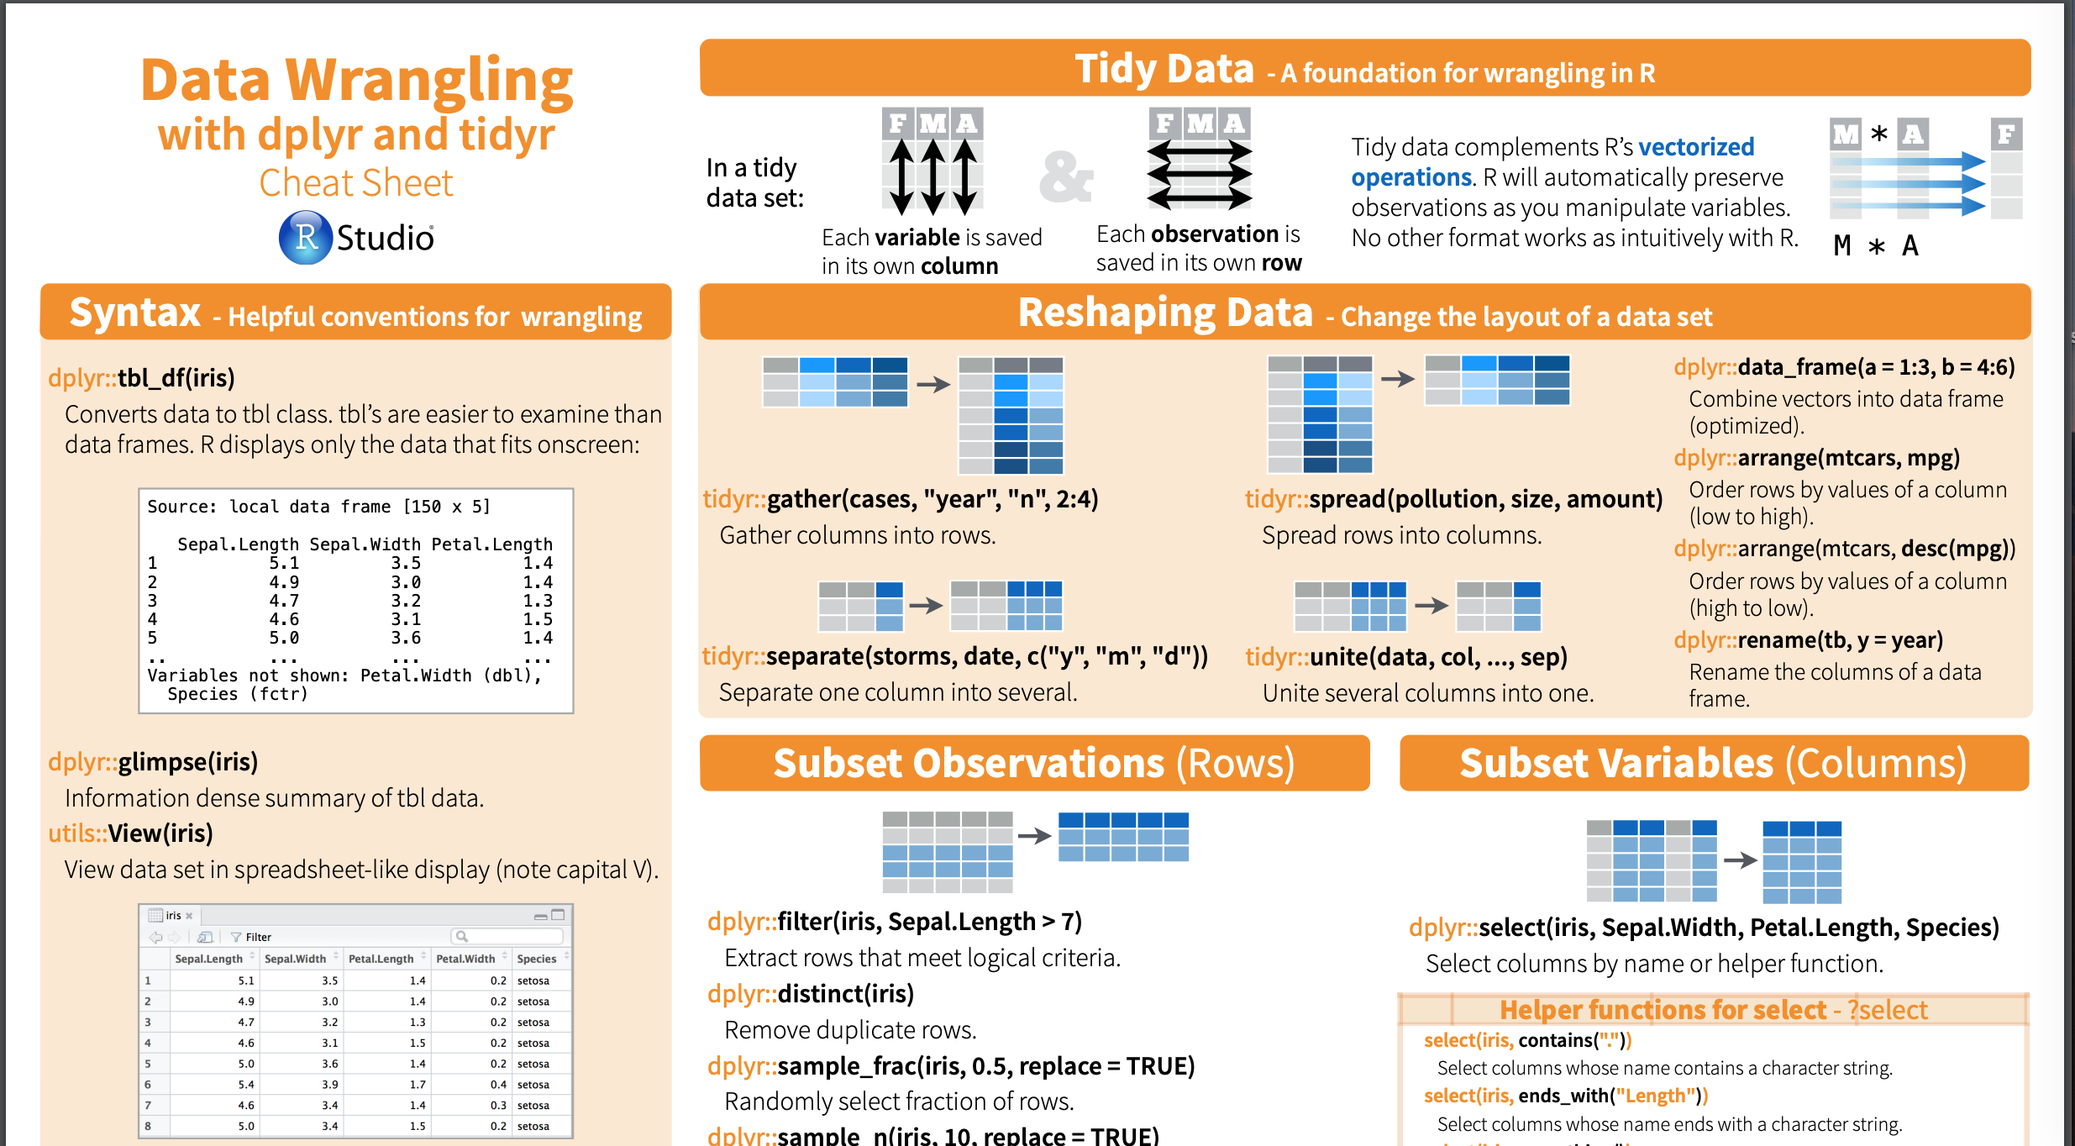
Introduction to dplyr
https://www.rstudio.com/wp-content/uploads/2015/02/data-wrangling-cheatsheet.pdf

Slide 12
Data structure
In computer science, a data structure is a data organization, management and storage format that enables efficient access and modification. [wikipedia]

Slide 13
Data structure in R
Two dimensional data: dataframe, matrix etc.
One dimensional data: vector, list, factor etc.

Slide 14
Basic functions in R
- The package named base contains the basic functions of the language
- No need for separate installation
- For reading and manipulating data

Slide 15
R packages
- Packages are units of reproducible R code
- They include:
- reusable R functions
- the documentation
- sample data
- others can easily download and use.

Slide 16
Data structure 01
Package 01
Data structure 02
Package 02

Slide 17
Data structure 01
Package 01
Data structure 02
Package 02

